Slide 1
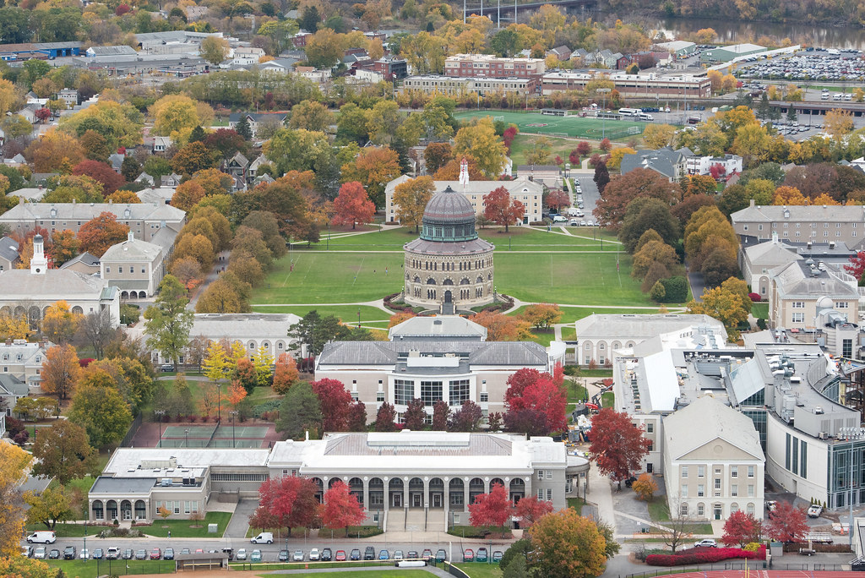
.
Union College
Schenectady, New York

Slide 2
2,096
Undergraduate Enrollment
Setting: City
Small Sized private liberal arts college

Slide 3
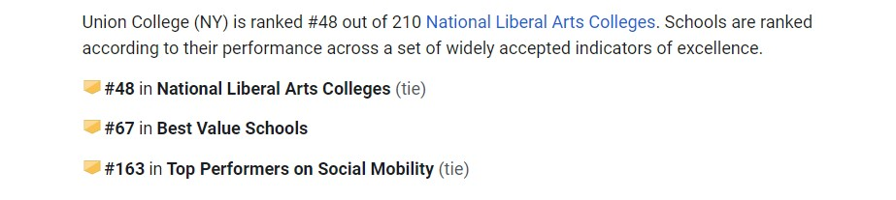
Ranking:

Slide 4
SAT Scores 75th percentile
Acceptance rate
english | maths | Total
700 | 730 | 1430
ED | Regular
61% | 41%
Average GPA: 3.4

Slide 5
Application Requirements
No application fees for international students
Apply online using Common Application or Coalition Application
Test Optional
Recommended Scores: TOEFL: 90 IELTS: 7.0
.

Slide 6
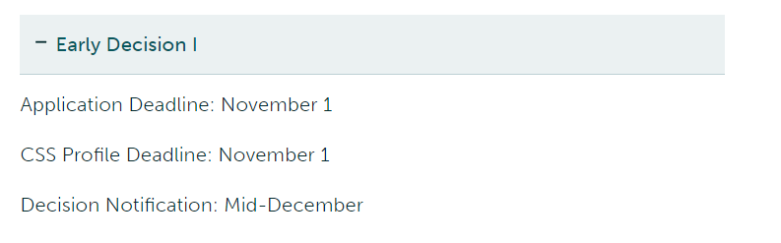
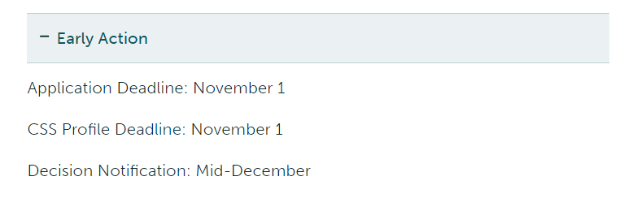
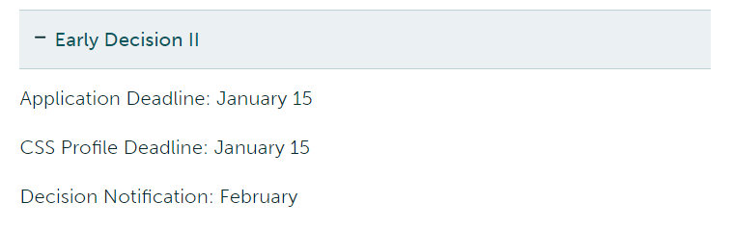
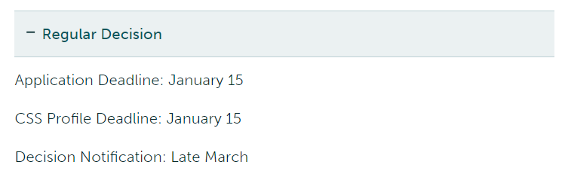
Application Deadlines
.

Slide 7
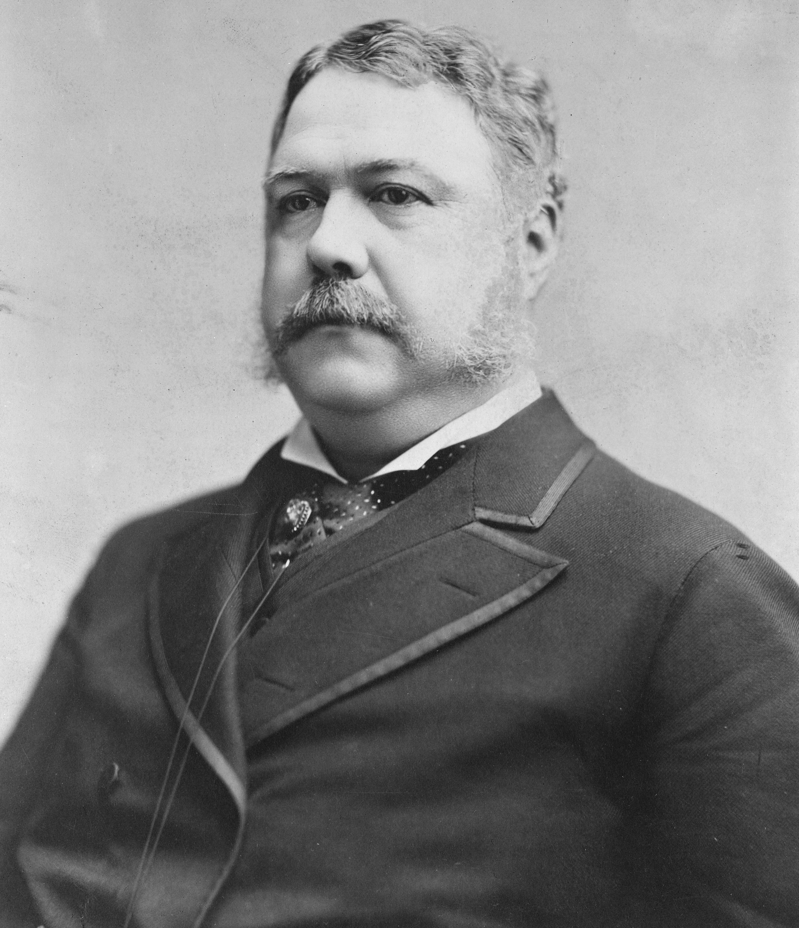
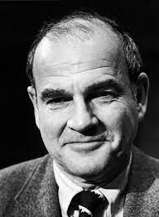
Notable Alumni
Chester A. Arthur
21st president of the United States from 1881 to 1885
Baruch Samuel Blumberg
Baruch Samuel Blumberg, known as Barry Blumberg, was an American physician, geneticist, and co-recipient of the 1976 Nobel Prize in Physiology or Medicine, for his work on the hepatitis B virus
.

Slide 8
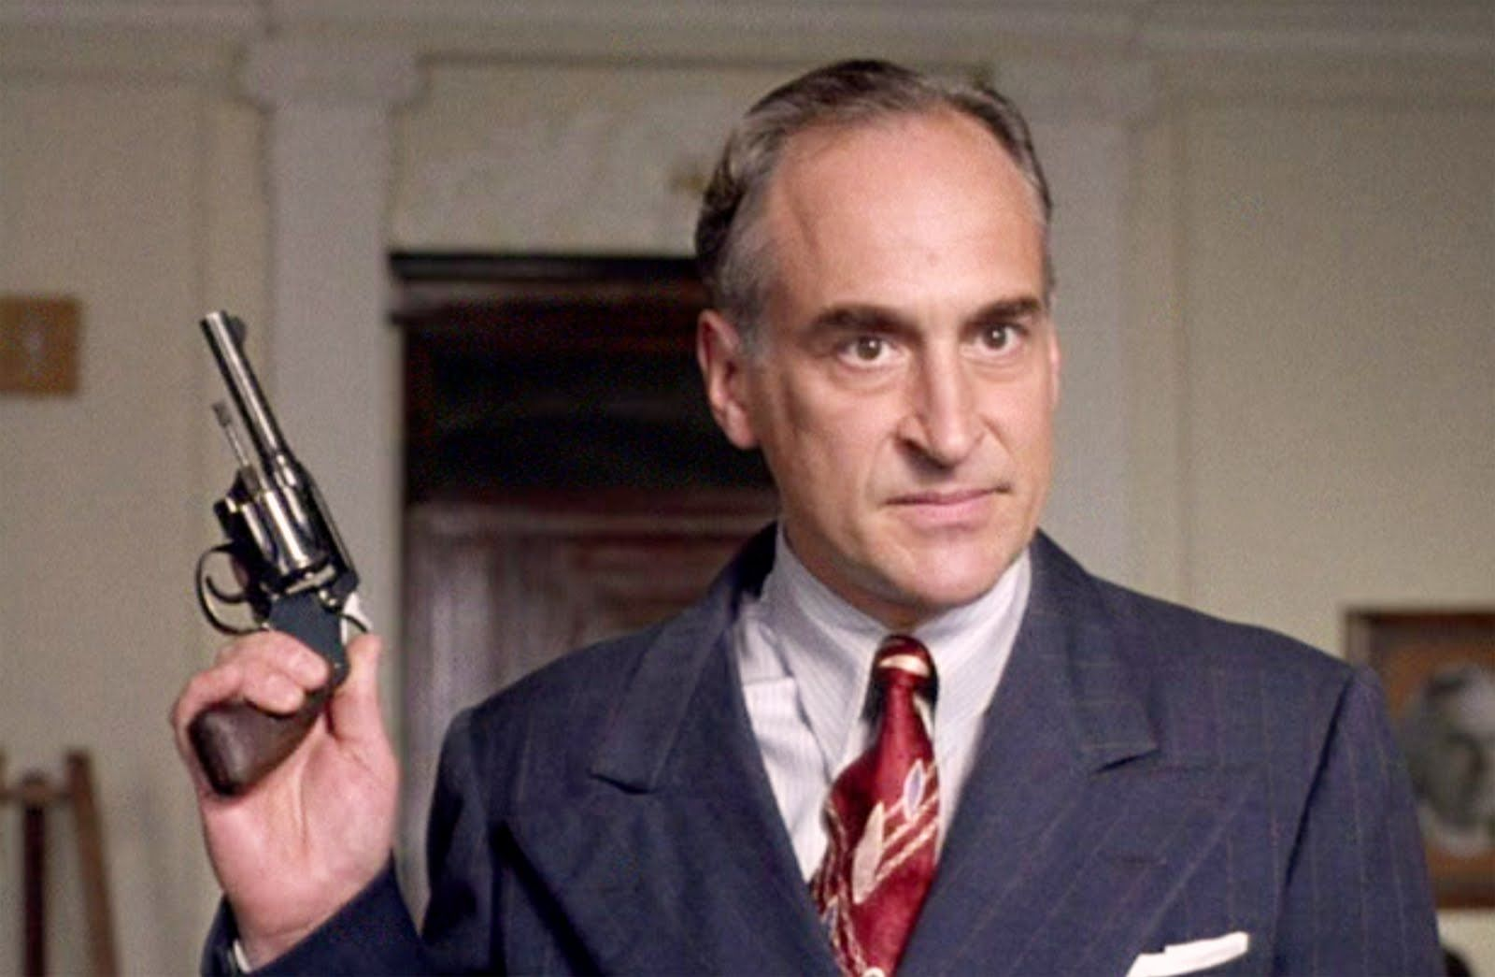
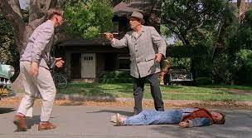
Notable Alumni in Entertainment
Jeffrey DeMunn
television, film and stage actor (The Green Mile, Law and Order, The Shawshank Redemption, The Majestic)
George DiCenzo
television, film and stage actor (Dynasty, Murder She Wrote, Law and Order, Back to the Future, Close Encounters of the Third Kind)
.

Slide 9
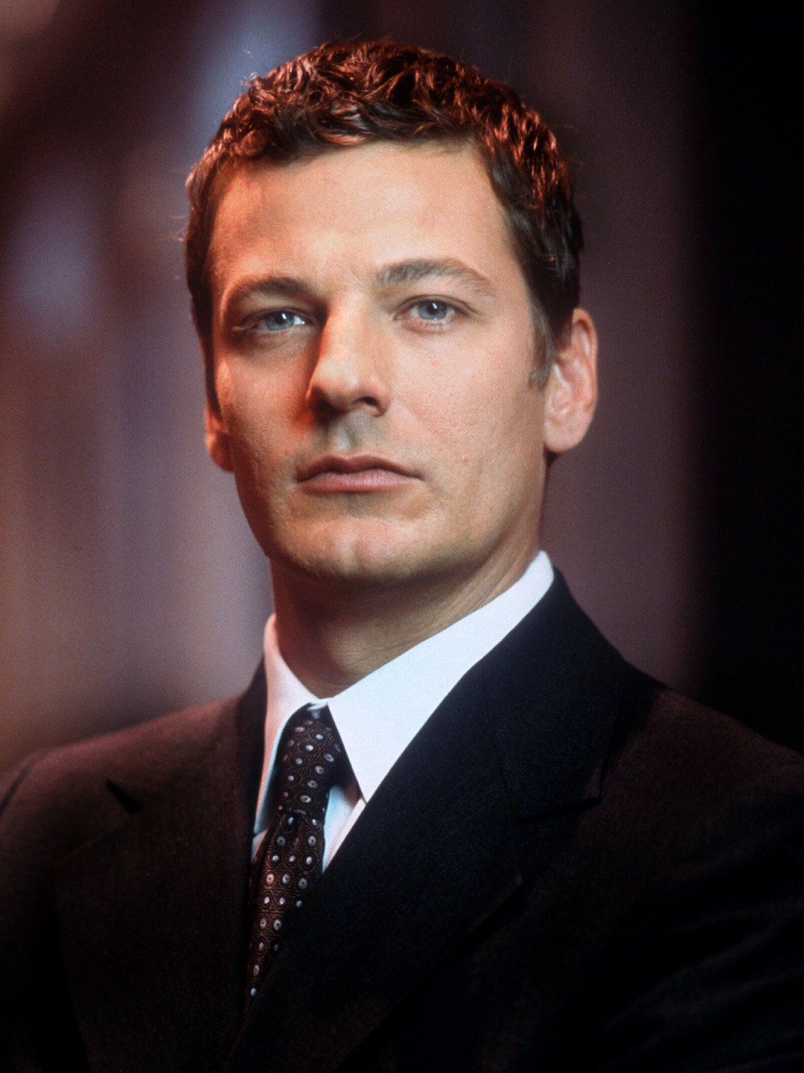

Notable Alumni in Entertainment
Adam Storke
actor (Mystic Pizza, Stephen King’s The Stand)
Alan Horn
CEO, Disney Studios; former president and COO, Warner Brothers; co-founder, Castle Rock Entertainment; producer (Seinfeld, When Harry Met Sally, City Slickers, A Few Good Men, Shawshank Redemption, The Green Mile, The Bucket List)
.

Slide 10

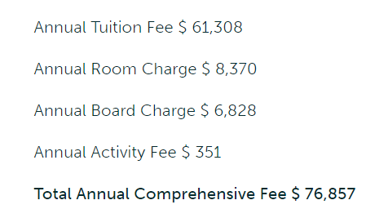
Fee Structure
Scholarships?
Both Need Based & Merit Based

Slide 11
Scholarships
Presidential Scholarship: From $18,000 to $30,000 per year
Need Based Scholarship:
International Students are eligible for need based aid.
Union College utilizes the CSS Profile to determine financial need. The College is need-aware in the admissions process, which means that financial information is considered along with the other components of your application during the admission evaluation.
They meet the full demonstrated financial need of all admitted students.

Slide 12
Scholarships
Presidential Scholarship: From $18,000 to $30,000 per year
Need Based Scholarship:
International Students are eligible for need based aid.
Union College utilizes the CSS Profile to determine financial need. The College is need-aware in the admissions process, which means that financial information is considered along with the other components of your application during the admission evaluation.
They meet the full demonstrated financial need of all admitted students.
They require minimum EFC of

Slide 13
Scholarships
Presidential Scholarship: From $18,000 to $30,000 per year
Need Based Scholarship:
International Students are eligible for need based aid.
Union College utilizes the CSS Profile to determine financial need. The College is need-aware in the admissions process, which means that financial information is considered along with the other components of your application during the admission evaluation.
They meet the full demonstrated financial need of all admitted students.
They require minimum EFC of $7,500

Slide 14
Majors and Minors
Biological Sciences
Computer Science
Data Analytics
Engineering
Film Studies
Mathematics
Psychology
Physics and others…….
………

Slide 15
Just for my friend Pritesh
………

Slide 16

UC Has Physics Major
………

Slide 17
UC Has Physics Major
UC Has Astronomy Major
………

Slide 18
UC Has Physics Major
UC Has Astronomy Major
UC Has Astrophysics Minor
………

Slide 19
Thank You

